Slide 1
BIOE 498 / BIOE 599
Advanced Biological Control Systems
Lecture 2: Elements of Closed Loop Systems
Joseph L. Hellerstein
January 8, 2025
eScience Institute, Computer Science & Engineering
Allen School of Computer Science
BioEngineering
Notes:
Diverse students. Some with bio-backgrounds; some without. Some with CS background; some with very limited. Two separate courses combined because of a substantial shared curriculum.

Slide 2
Agenda
Terminology
Controllers
Filters
Testbed-based control design

Slide 3
Signals & Systems
$$t$$ | $$x\left(t\right)$$
1 | 0.2
2 | 0.4
3 | 0.8
4 | 1.6
Signal
  a time series
System
  Transforms one signal(s) into another signal(s)
$$t$$ | $$x\left(t\right)$$
1 | 0.2
2 | 0.4
3 | 0.8
4 | 1.6
$$t$$ | y$\left(t\right)$
1 | 0.2
2 | 0.6
3 | 1.2
4 | 2.4
$$y\left(t\right)=x\left(t\right)+x(t−1)$$

Slide 4



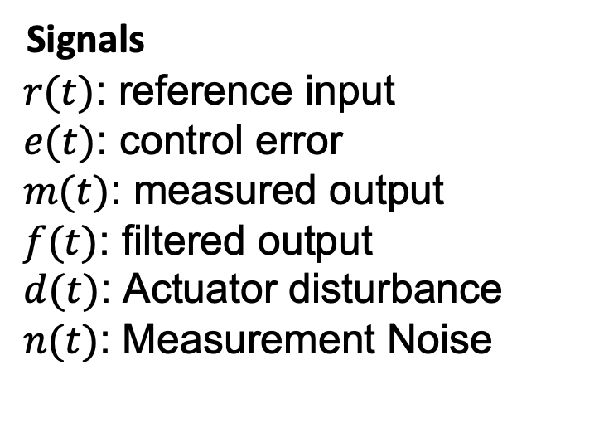









Control Architecture
Actuator
Disturbance
Measurement
Noise
$$d(t)$$
$$n(t)$$
$$e(t)$$
$$y(t)$$
$$r(t)$$
Controller
$$u(t)$$
C
m$(t)$
+
+
$$OLS$$
+
$$−$$
m$(t)$
f$(t)$
$$Filter$$
Signals
$r(t)$: reference input
$e(t)$: control error
$m(t)$: measured output
$f(t)$: filtered output
$d(t)$: Actuator disturbance
$n(t)$: Measurement Noise
Systems
Open loop system (OLS)
Controller
Filter
C (compensation)
Notes:
Why doesn’t a filter help with measurement noise? Verify transfer functions.

Slide 5



Control Architecture Without d(t), n(t)
Actuator
Disturbance
Measurement
Noise
$$0(t)$$
$$0(t)$$
$$e(t)$$
$$y(t)$$
$$r(t)$$
Controller
$$u(t)$$
C
m$(t)$
+
+
$$OLS$$
+
$$−$$
m$(t)$
f$(t)$
$$Filter$$
Notes:
Why doesn’t a filter help with measurement noise? Verify transfer functions.

Slide 6


Control Architecture Without r(t), d(t)
Actuator
Disturbance
Measurement
Noise
0$(t)$
$$n(t)$$
$$e(t)$$
$$y(t)$$
0$(t)$
Controller
$$u(t)$$
C
m$(t)$
+
+
$$OLS$$
+
$$−$$
m$(t)$
f$(t)$
$$Filter$$
Notes:
Why doesn’t a filter help with measurement noise? Verify transfer functions.

Slide 7


Control Architecture Without r(t), d(t)
setpoint
Controller
C
output
+
$$OLS$$
$$−$$
$$Filter$$
Notes:
Why doesn’t a filter help with measurement noise? Verify transfer functions.

Slide 8






Proportional, Integral, Differential (PID) Controllers
$$r(t)$$
$$e(t)$$
$$u(t)$$
$$y(t)$$
Controller
+
$$OLS$$
+
$$−$$
PID controllers are widely used.
3 different control mechanisms that can be used in combination
All have a single input and a single output.
All make use of the control error.

Slide 9
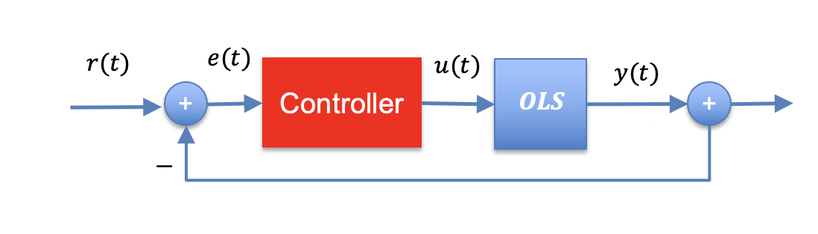




Proportional Control
$$u\left(t\right)=k_{P}e(t)$$
$$e(t)$$
$$u(t)$$
$$k_{p}$$
Only takes into account the current error.
Appeal
Simplicity, responds to change in current control error.
Issues
Biased since once at reference value, u(t) goes to 0.

Slide 10


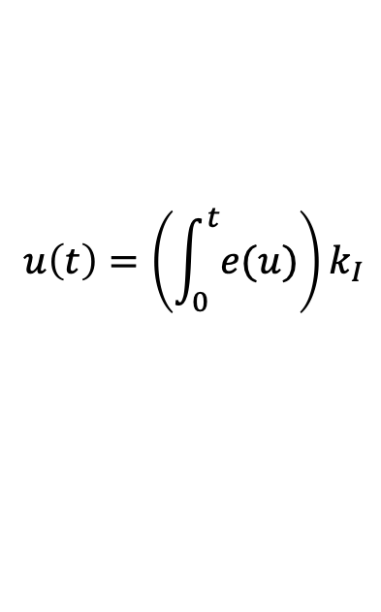
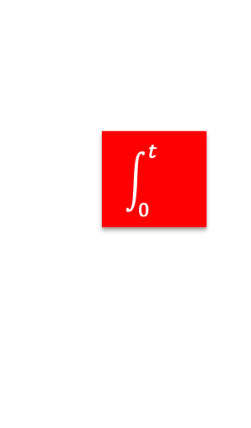


Integral Control
$$u\left(t\right)=\left(\int_{0}^{t}{e(u)}\right)k_{I}$$
$$e(t)$$
$$u(t)$$
$$\int_{0}^{t}{}$$
$$k_{I}$$
$$K_{p}$$
Considers entire history of control errors.
Appeal
Unbiased
Issues
Slow response

Slide 11


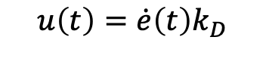



Differential Control
$$u\left(t\right)=\dot{e}\left(t\right)k_{D}$$
$$e(t)$$
$$u(t)$$
$$\frac{d}{dt}$$
$$k_{D}$$
$$K_{p}$$
Senses change in control errors.
Appeal
Fast response to changes.
Issues
Works poorly with noise.

Slide 12

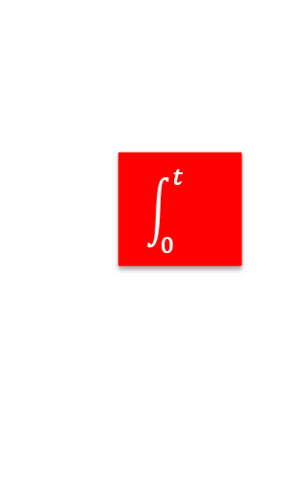















Common Controllers
PI Control
$$k_{P}$$
$$e(t)$$
$$u(t)$$
$$u(t)$$
$$k_{P}$$
$$e(t)$$
+
$$\int_{0}^{t}{}$$
$$k_{I}$$
P Control
$$K_{p}$$
PID Control
PI Control
$$k_{P}$$
$$e(t)$$
$$\int_{0}^{t}{}$$
$$k_{I}$$
$$u(t)$$
$$K_{p}$$
+
$$\frac{d}{dt}$$
$$k_{D}$$

Slide 13
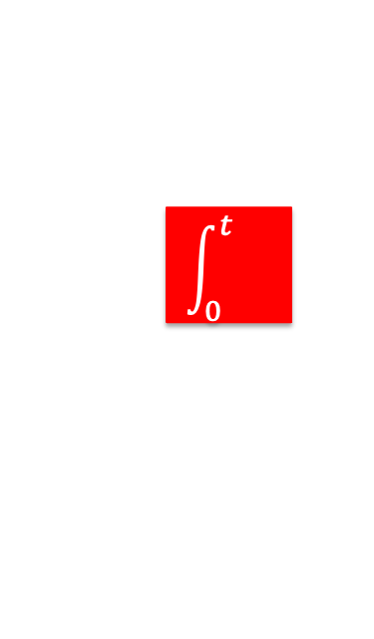


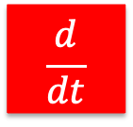


Common Controllers
PI Control
PID Control
$$k_{P}$$
$$\int_{0}^{t}{}$$
$$k_{I}$$
$$K_{p}$$
+
$$\frac{d}{dt}$$
$$k_{D}$$

Slide 14
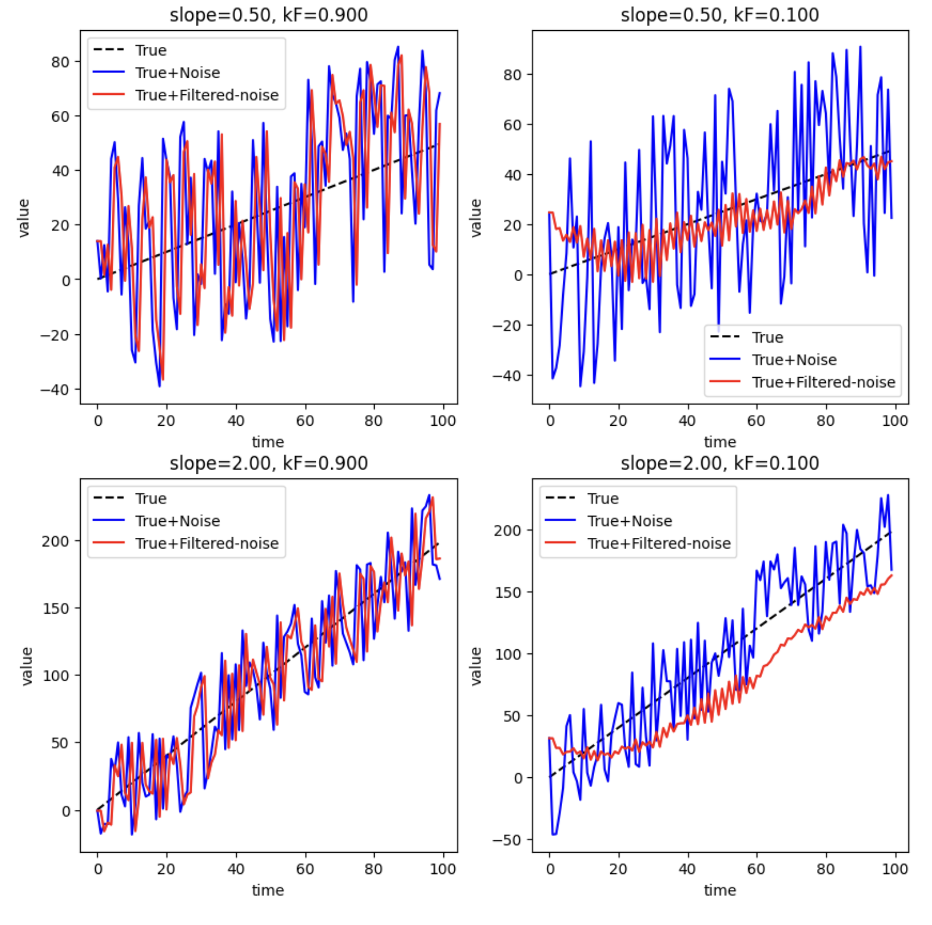






Filters
+
Controller
+
$$OLS$$
+
-
$$Filter$$
Discrete time
$$y(k)={k_{F}u\left(k\right)+\left(1−k_{F}\right)y(k−1)}_{}^{}$$
$$k_{F}∈[0,1]$$
Continuous time state equations
$$\dot{y}=k_{F}^{′}u−k_{F}^{′}y,$$
$$k_{F}^{′}>0$$
Rule of thumb:
Use small k_{F} for weak signal
Use large k_{F} for strong signal

